Slide 1
FROZEN THEME FOODS
PRESENTED BY
J.PRIYANKA
H.N.DIVYA
G.PRIYANKA

Slide 2
Freezing is one of the oldest and most widely used methods of food allows preservantion, which allows preservation of taste,texture,and nutritional value in food better than any other method.
The fereezing process is a combination of the beneficial effects of low temparatures at which micro organisms cannot grow.
Freezing preservation retains the quality of agricultural products over long storage period.

Slide 3
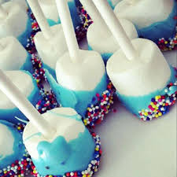

Slide 4


